Slide 1
BLOCKCHAIN-BASED COUNTERFEIT MEDICINE AUTHENTICATION SYSTEM

Slide 2
ABSTRACT
The escalation of counterfeit medicines within the global market poses a significant threat to public health, necessitating innovative technological interventions. We propose a cutting-edge web application that employs blockchain technology to assure the authenticity of pharmaceutical products. This application is uniquely designed to centralize control in the hands of drug administrators, who play a pivotal role in registering and managing all pertinent details related to medicines, manufacturers, and distributors on the blockchain. This approach not only streamlines the management process but also ensures a higher level of security and integrity within the pharmaceutical supply chain.

Slide 3
CONT… ABSTRACT
Centralized Management by Drug Administrators: The web application features a robust administrative portal through which drug administrators can add, update, and manage comprehensive details about medicines. This includes formula information, expiry dates, pricing, and the specifics of their respective manufacturers and distributors. By centralizing these functions, the application ensures that all information on the blockchain is verified and authorized, thereby preventing unauthorized modifications, and enhancing the reliability of the data.
Blockchain Integration for Authentication: At the core of the application is the blockchain technology that records every detail entered by the drug administrator, creating an immutable and transparent ledger. This ledger serves as the foundation for verifying the authenticity of medicines, enabling a secure and trustworthy verification process for end-users.

Slide 4
INTRODUCTION
In the global healthcare ecosystem, the integrity of the pharmaceutical supply chain is of paramount importance. The circulation of counterfeit medicines poses a grave threat to public health, undermining the efficacy of healthcare treatments and, in some cases, leading to fatal outcomes. According to the World Health Organization (WHO), counterfeit medicines account for an estimated 10% of the global pharmaceutical market, affecting every country and having a particularly devastating impact in low- and middle-income regions. These counterfeit products range from life-saving medications to routine prescription drugs, compromising patient safety and eroding trust in healthcare systems.

Slide 5
PROBLEM STATEMENT
The global pharmaceutical industry faces a critical challenge in combating the pervasive issue of counterfeit medicines, which pose significant risks to public health and undermine trust in healthcare systems. Despite existing regulatory frameworks and traditional track-and-trace technologies, the current systems are plagued by vulnerabilities such as tampering, lack of transparency, data security risks, operational inefficiencies, and limited standardization across global markets. These limitations facilitate the entry of counterfeit drugs into the supply chain, making it difficult for stakeholders to verify product authenticity effectively. Consequently, there is an urgent need for an innovative solution that can address these challenges by enhancing the security, transparency, and traceability of pharmaceutical products, thereby ensuring the integrity of the supply chain and safeguarding patient safety.

Slide 6
LITERATURE REVIEW
S.NO | PAPER TITLE | AUTHORS | KEY FEATURES | METHODOLOGY | ACCURACY | LIMITATIONS
1 | A Blockchain Based Solution for Medication Anti-Counterfeiting and Traceability | Peng Zhu, Jian Hu, Yue Zhang and Xiatong. | - Blockchain technology - Traceability -Security and privacy protection. - Transparency and Effectiveness | This research proposes a blockchain method for medication anti-counterfeiting, utilizing decentralization and tamper-proofing. Access controls and an improved consensus mechanism enhance efficiency and security in simulations. | 90% to 100% | -Scalability issues. -Privacy Concerns. -Limited Consideration of Socioeconomic Factors

Slide 7
2 | Blockchain Based Counterfeit Medicine Authentication System | Nazmul Alam, Md Rabiul Hasan Tanvir, Sadah Anjum Shanto. | -Transparent and reliable. -Transaction security -Data safety -Privacy of traceability data. -Ensuring Authenticity. | The prototype methodology employs a private blockchain system, validated by a drug administrator, ensuring transparency in the medication supply chain. It includes encrypted transaction data, real-time location recording, and a data reduction process for expired medicines, allowing customers to verify authenticity via QR code scanning. | 95% to 99% | -Limited Exploration of Cost Implications. -Assumption of Universal Smartphone Access. -Insufficient Discussion on Regulatory Challenges.

Slide 8
3. | Blockchain to Overcome Counterfeiting of Medicines | Moksh Jain, Adithya Bijur, Nilesh Chavan And Prof. Sweety Rupani | -Blockchain-enabled Medicine Traceability. -End-User Verification. -Improved Patient Safety. -Accessibility and Protection. | The proposed system employs blockchain for transparent medicine supply chain management, with manufacturers generating hash codes stored in the blockchain, enabling traceability and authenticity verification by stockists, distributors, retailers, and end-users. The central authority oversees the supply chain, and a mobile app GUI facilitates scanning for retailers and customers.Top of Form | 90% | -Scalability Challenges. -Limited Stakeholder Adoption Discussion. -Technical Implementation Risks.

Slide 9
4. | Safeguarding Against Counterfeit With Blockchain Bases QR Code | G. Bhanu Prasad, P. Shreya, P. Shailaja, M. Akhila, P. Sravani | - Fighting counterfeiters on a legal level. -A good alert system, -Tamper-proof. -Authentication | the proposed methodology assesses blockchain's role in countering counterfeiting, proposing a holistic strategy with a decentralized supply chain (block-supply chain) for enhanced security and efficiency. | 95% to 99% | -Technological Means Alone Insufficient. -Need for Complementary Measures. -Broader Factors at Play.

Slide 10
5 | Authentication of Product & Counterfeits Elimination Using Blockchain. | Tripti Rathee Manoj Malik | -Decentralization -Immutable -Transactions -Authentication Module -Track and Trace -Consensus -Protocol -Integration with -Existing -Technologies -User Interface. | Users scan product QR code triggering authentication checks recorded on the blockchain, ensuring product authenticity and enabling traceability. The system utilizes a consensus protocol to maintain integrity, while the user interface provides transparency and accessibility to scan history. | 90% to 99% | -Dependency on QR technology: The system relies on QR for product authentication -Scalability challenges: As the system grows in usage and data volume, scalability issues may arise due to the resource-intensive nature of blockchain technology, potentially leading to slower .

Slide 11
EXISTING SYSTEM
The existing systems for combating counterfeit medicines primarily rely on regulatory frameworks, physical inspections, and traditional track-and-trace technologies. These approaches often involve centralized databases and serial number tracking mechanisms, such as barcodes or RFID tags, to monitor the movement of pharmaceutical products through the supply chain. While these methods have provided a level of oversight and control, they are susceptible to tampering, fraud, and operational inefficiencies. The centralized nature of data storage also poses risks of data breaches and lacks the transparency needed for all stakeholders to verify product authenticity independently. Consequently, these systems face challenges in ensuring the integrity of pharmaceutical products, leading to continued prevalence of counterfeit medicines and a pressing need for more secure, transparent, and efficient solutions.

Slide 12
LIMITATIONS OF EXISTING SYSTEM
Vulnerability to Counterfeiting and Tampering: Traditional track-and-trace technologies, such as barcodes and RFID tags, can be replicated or tampered with, making it possible for counterfeit products to enter the supply chain undetected.
Lack of Transparency: Centralized databases do not provide visibility into the supply chain for all stakeholders. This lack of transparency makes it difficult for consumers, retailers, and healthcare providers to independently verify the authenticity of medicines.
Data Security Risks: Centralized systems are susceptible to cyber-attacks and data breaches, which can compromise sensitive information about medicines, manufacturers, and distribution channels.
Operational Inefficiencies: The reliance on manual inspections and regulatory audits can be time-consuming and resource-intensive, leading to bottlenecks and delays in the supply chain.
Limited Global Standardization: Different countries and regions may employ varying standards and technologies for drug authentication, complicating efforts for global pharmaceutical companies to ensure compliance and maintain product integrity across markets.

Slide 13
AIMS AND OBJECTIVES
The primary goal of this web application is to empower drug administrators with a comprehensive tool for managing the authenticity and traceability of medicines. By providing a singular point of control and a transparent verification process, the application aims to drastically reduce the prevalence of counterfeit medicines, safeguard public health, and restore trust in the pharmaceutical industry's supply chain.

Slide 14
PROPOSED METHODOLOGY
The proposed Blockchain-Based Counterfeit Medicine Authentication System addresses the limitations of existing systems by leveraging the immutable, decentralized nature of blockchain technology to enhance the security, transparency, and traceability of pharmaceutical products throughout the supply chain. By utilizing encrypted QR codes unique to each medicine package, the system enables secure and instant verification of product authenticity by all stakeholders, from manufacturers to end consumers. This approach not only minimizes the risk of counterfeit medicines entering the supply chain but also empowers consumers with the ability to independently verify their medications. Additionally, the blockchain framework ensures that all transaction records are tamper-proof and readily accessible, thereby significantly reducing operational inefficiencies and data security risks. Through its innovative use of blockchain and QR code technology, the proposed system offers a scalable, standardized solution to combat counterfeit medicines globally, enhancing public health and safety.

Slide 15
ADVANTAGES OF PROPOSED SYSTEM
Enhanced Security: The use of blockchain technology ensures that all data recorded on the ledger is immutable and tamper-proof. This significantly reduces the risk of counterfeit medicines entering the supply chain, as any attempt to alter transaction records or medicine information can be easily detected and traced.
Increased Transparency: The decentralized nature of blockchain allows all stakeholders in the pharmaceutical supply chain, including manufacturers, distributors, healthcare providers, and consumers, to have visibility into the history and authenticity of medicine transactions. This level of transparency ensures that stakeholders can independently verify product authenticity at any point in the supply chain.
Improved Traceability: Encrypted QR codes on medicine packaging provide a unique and secure method of tracing the journey of pharmaceutical products from production to consumption. This traceability facilitates the identification of counterfeit products and helps in quickly recalling compromised medicines, thereby enhancing patient safety.
Operational Efficiency: The automation of verification processes through smart contracts and the elimination of intermediaries streamlines operations within the supply chain. This not only reduces the time and cost associated with manual checks and regulatory compliance but also minimizes the risk of human error.

Slide 16
USE CASE DIAGRAM

Slide 17
ACTIVITY DIAGRAM

Slide 18
CLASS DIAGRAM

Slide 19
SEQUENCE DIAGRAM

Slide 20
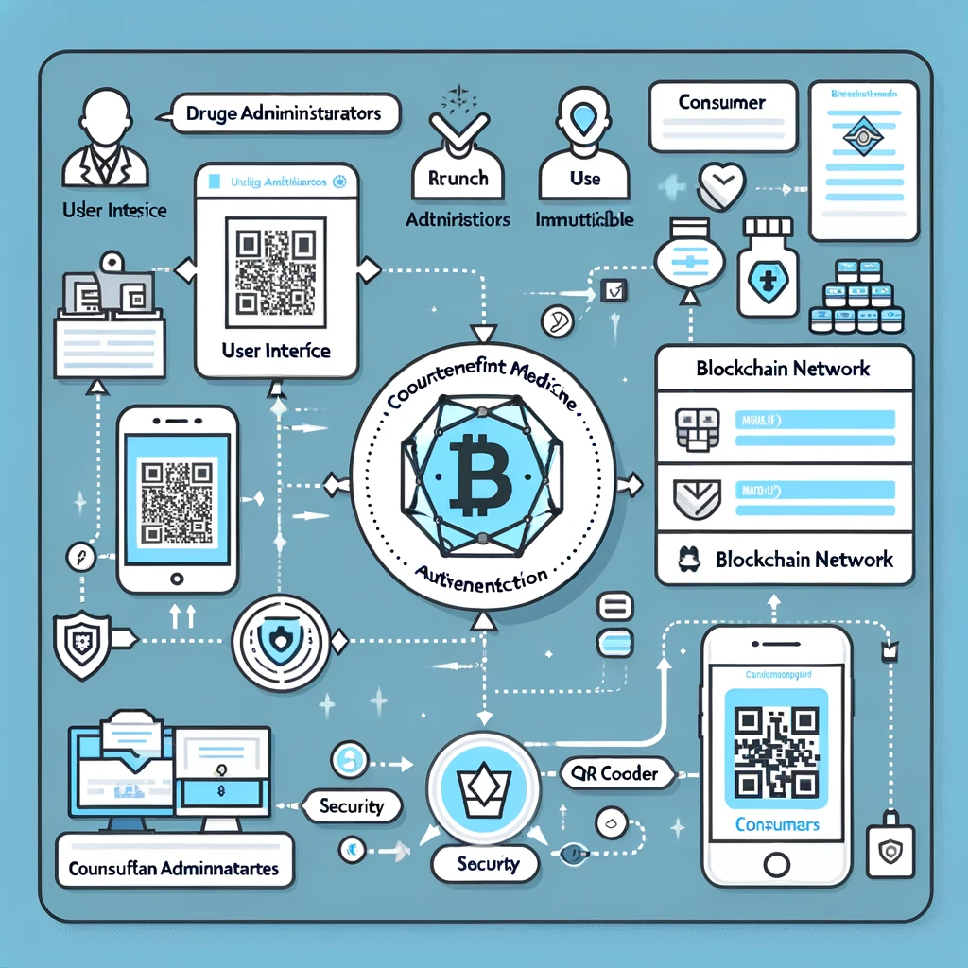
SYSTEM ARCHITECTURE

Slide 21
CONCLUSION
The Blockchain-Based Counterfeit Medicine Authentication System represents a significant leap forward in addressing the critical issue of counterfeit medicines within the pharmaceutical supply chain. By leveraging the inherent strengths of blockchain technology—its immutability, transparency, and decentralized nature—this project introduces a robust framework for ensuring the authenticity and traceability of medicines from production to consumption. The innovative use of encrypted QR codes for product verification further enhances the system's capability to provide end-users with a simple yet effective tool for confirming the authenticity of their medications.

Slide 22
SYSTEM REQUIREMENTS
HARDWARE REQUIREMENTS
MINIMUM (Required for Execution) |  | MY SYSTEM (Development)
System | Pentium IV 2.2 GHz | i3 Processor 5th Gen
Hard Disk | 20 Gb | 500 Gb
Ram | 1 Gb | 4 Gb

Slide 23
SYSTEM REQUIREMENTS
SOFTWARE REQUIREMENTS
Operating System | Windows 10/11
Development Software | Python 3.10
Programming Language | Python
Integrated Development Environment (IDE) | Visual Studio Code
Front End Technologies | HTML5, CSS3, Java Script
Back End Technologies or Framework | Django
Database Language | SQL
Database (RDBMS) | MySQL
Database Software | WAMP or XAMPP Server
Web Server or Deployment Server | Django Application Development Server
Design/Modelling | Rational Rose

Slide 24
THANK YOU

